Slide 1
Exploratory Data Analysis(EDA) on Bike Sharing in San Jose
Colab Link

Slide 2
EDA high level summary
Data analysis method: Google Colab LINK
All the analysis below can be easily found in the colab by searching for the summary statistics name
Description of variables and basic statistics
Preliminary steps
Handle NaN in the dataset
Calculations of summary statistics and metrics
User group analysis : Registered vs Unregistered user ratio in the dataset
Bike ride count per member and bike type
Geographical analysis on bike ride with map
Number of bike rides on weekdays/weekends for Member(registered) vs. Casual(unregistered)
Create new metric: Daily Bike Occupancy Index
Bike usage trend for 1 month
Dailye bike ride demand trend per bike type
Hourly trip data for each user type
Ride time duration related data analysis
Ride distance related data analysis
Conclusions and next step (Remaining questions)

Slide 3
Description of variables and basic statistics
The data is loaded to the dataframe based on Python pandas library
13 columns of variables in the bike ride data.
Categorical feature : 9 variables (features)
ride_id : Unique ride event id
rideable_type : types of bikes(electric, classic ,and docked bike)
start_station_name : name of station where bike ride starts
start_station_id : start station identification code
end_station_name : name of station where bike ride ends
end_station_id: start station identification code
started_at : bike ride start time in YYYY-MM-DD HH:MM:SS format
ended_at : bike ride end time in YYYY-MM-DD HH:MM:SS format
member_casual : type of bike user , member(registered) vs casual(unregistered)
Numerical feature : 4 variables(features)
start_lat : latitude of start station
start_lng : longitude of start station
end_lat : latitude of end station
end_lng : longitude of end station

Slide 4
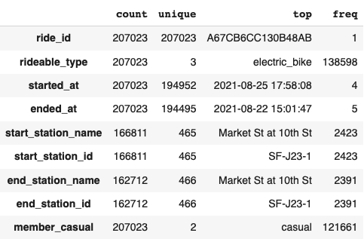
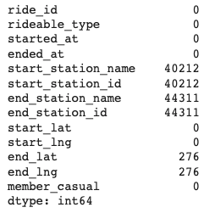
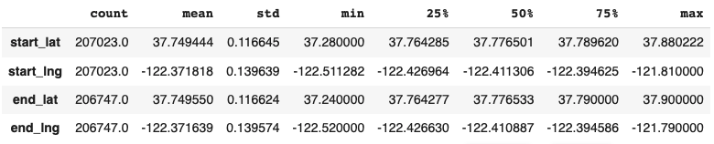
Description of variables and basic statistics
Baseline statistics
Categorical feature basic statistics
NaN and Null in the dataset
Numerical feature basic statistics

Slide 5
Preliminary step: Handle NaN
Rule 1: "start/end station name" and "start/end station id" have non-negligible amount of NaN. They need to be properly handled instead of removing them from dataset
Main idea : Some rows don’t have Station name but they all have coordinate (latitude, longitude). If there exist other rows with similar (latitude, longitude) and valid station name/id, they can be used to fill the missing NaN station name/id
Rule 2: end_lat/lng columns have only 276 NaN out of 207023 elements, which is just 0.133%. Also if "end_lat" and "end_lng" are NaN, station name and id are also NaN. That makes these NaN datasets are not useful for data analysis. These NaN can be removed.
NaN count
Station name/id | Other feature | latitude | longitude
NaN | : | 10.123xxx | 10.123xxx
: | : | : | :
7th Ave at Cabrillo St | : | 10.123xxx | 10.123xxx
Fill NaN with station name/id with almost identical coordinate
Consider them same location since value up to thousandths digits are same
All NaN in station name/id can be filled in this method

Slide 6
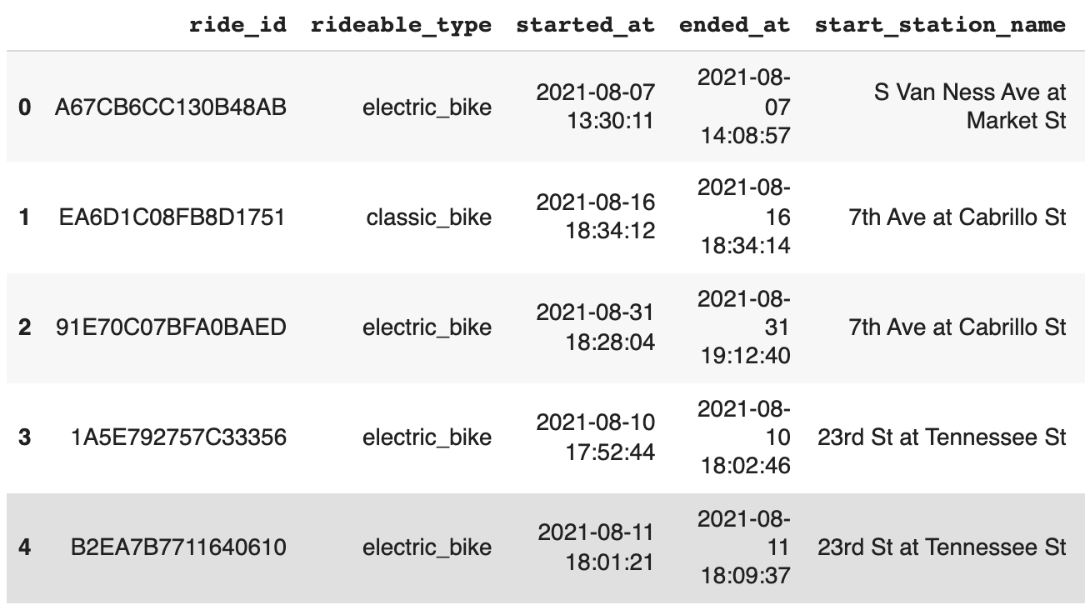
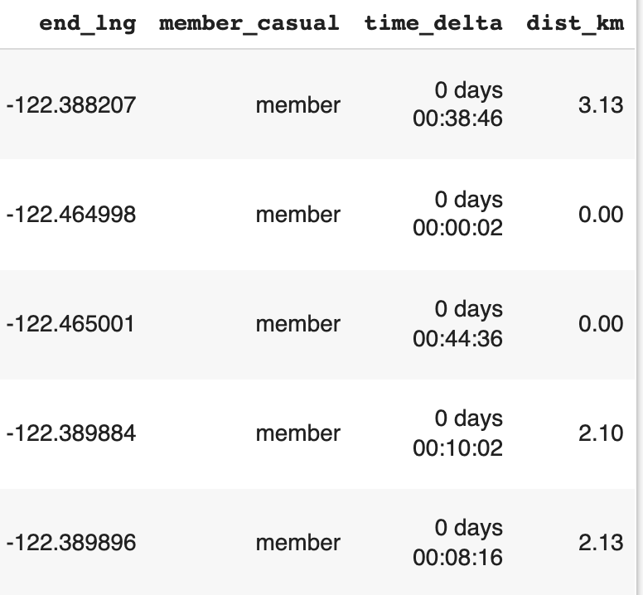
Preliminary step: Distance and Time duration
Travel distance(“dist_km” in dataframe) : The original data has latitude and longitude of bike ride start/end station. Travel distance is computed from the coordinate of the two locations.
Two coordinates are not intuitive when trying to understand the distance between them
Distance based on coordinate computation reference https://en.wikipedia.org/wiki/Haversine_formula
https://towardsdatascience.com/heres-how-to-calculate-distance-between-2-geolocations-in-python-93ecab5bbba4
Time duration(“time_delta” in dataframe) : From the start and end time-stamp of the bike ride, ride time duration can be computed and added to the dataframe

Slide 7
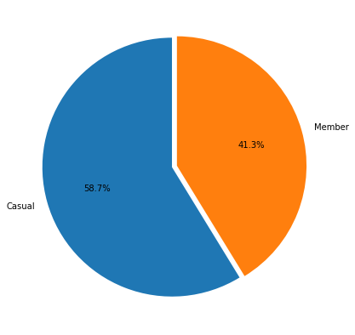
Summary statistics and metrics
User group analysis
Method: As a first step of bike sharing data analysis, member vs casual user bike sharing service usage ratio is analyzed. Pie plot is the most frequently used visualization method for percentage of each group.
Member : Registered user
Casual: Unregistered user
Observation: As shown in the graph, there are more casual users then member. This is somewhat obvious since this kind of trend can be easily found in many other paid subscription services such as “Google” and “Pandora” ad-free option

Slide 8
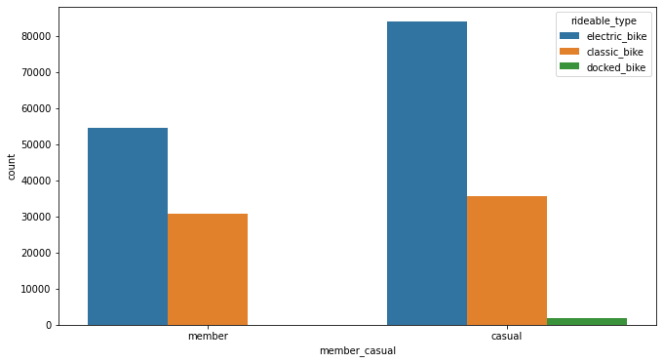
Summary statistics and metrics
Bike ride count per user and bike types
Observation
In each user group, electric bikes are used more than other bike types
Casual users tends to ride more electric bike than the member user
Electric bike demand trend will be investigated in the later section of the slide
There are less than 3000 docked bike ride history which is negligible to other bike types.

Slide 9
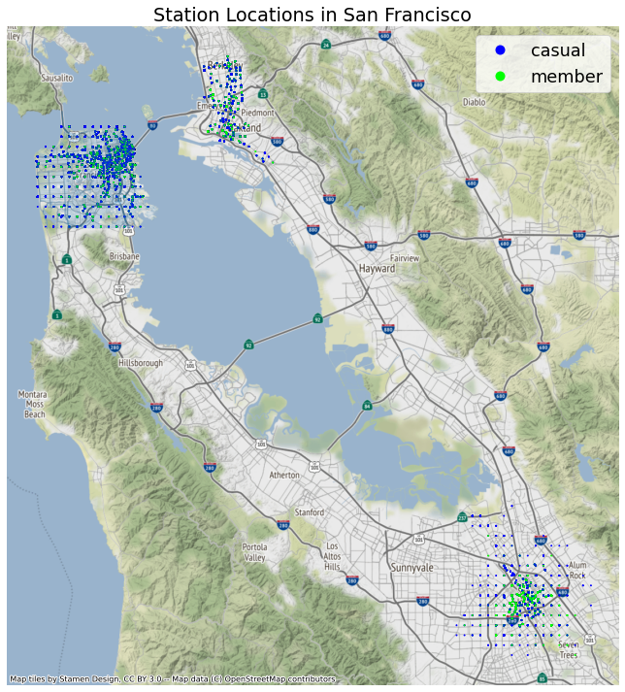
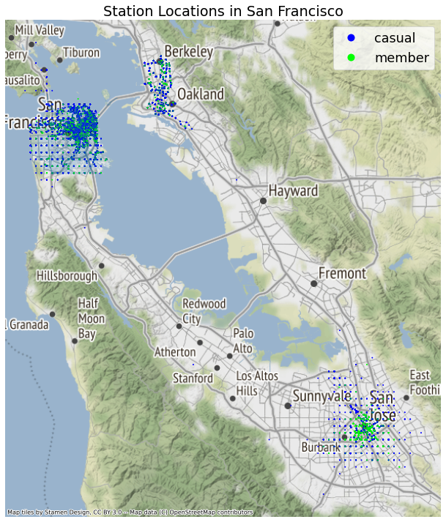
Summary statistics and metrics
Geographical analysis on Bike ride
Method: Start and End station locations are directly mapped to the bay area map to understand the geospatial distribution of bike ride. (Ref https://medium.com/@sindhu.ravikumar/visualizing-spatial-data-with-geopandas-and-contextily-10e9b8e71e49)
Observation:
Most rides are concentrated on the most popular station : More bikes needed in this location
Most popular station on red circle
Start station distribution
End station distribution
Market st at 10th st
MacArcdher Bart Station
Market st at 10th st
MacArcdher Bart Station
Saint James Park
Saint James Park

Slide 10
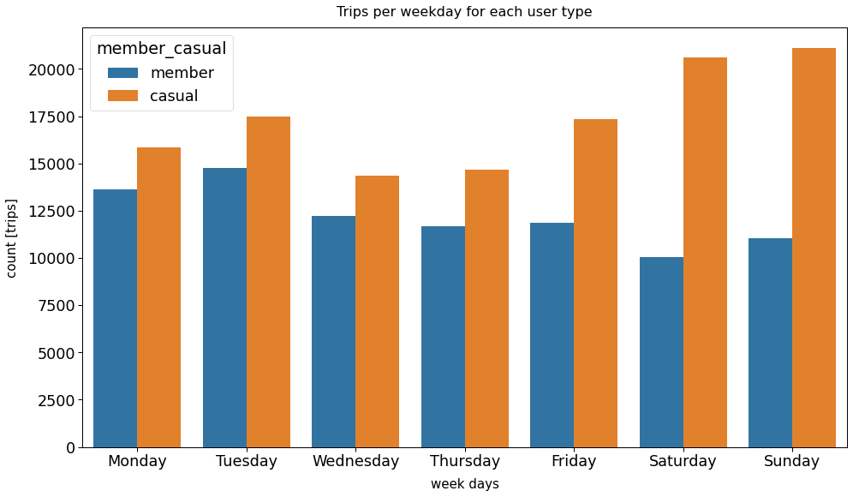
Summary statistics and metrics
Bike ride comparison : Weekend vs Weekdays per member type
Observation : Casual and Member have very different ride behavior. Bike rides of casual user significantly increases during the weekends
It is possible that registered user use bikes mainly for commuting so bike rides count reduces during the weekends.
Similarly, unregistered users might use bike for non-commuting purpose such as sightseeing and hiking during the weekend.

Slide 11
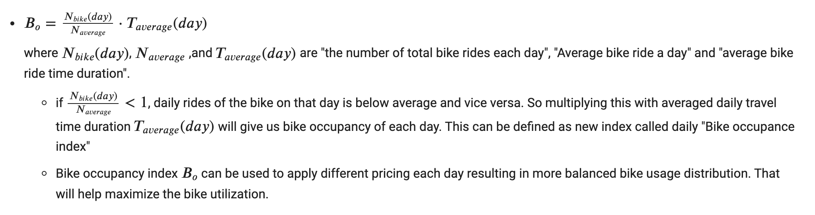
Summary statistics and metrics
New metric: Daily bike occupancy index (1)
Motivation: In addition to the daily bike ride statistics, it is also important to understand how long bike users occupy once they start bike sharing service. The occupancy can be important factor in better bike allocation and purchase decision in addition to overall bike ride statistics

Slide 12
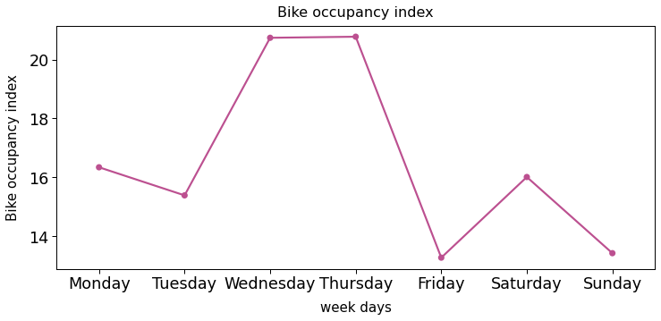
Summary statistics and metrics
New metric: Daily bike occupancy index (2)
New Metric
Finding 1: The result shows that bike ride occupancy gradually increases from Monday to Thursday. Then it drops to Friday suddenly.
This is quite opposite to Bike ride count. It means that during the weekdays, many people don't return the bike erly and just occupies it.
Finding 2: Even though more bikes are used during the weekend, bike occupance is not high. It means that many people use bike for relatively shorter time during weekend than during the weekdays
Suggestion:
To improve the bike utilization during weekdays, one can consider promotion or credit to early bike return users → reduce occupancy
Instead of purchasing more bikes to handle the weekend demand, it might be better to increase the bike re-allocation staffs for better bike circulation.
Occupancy don’t follow ride count

Slide 13
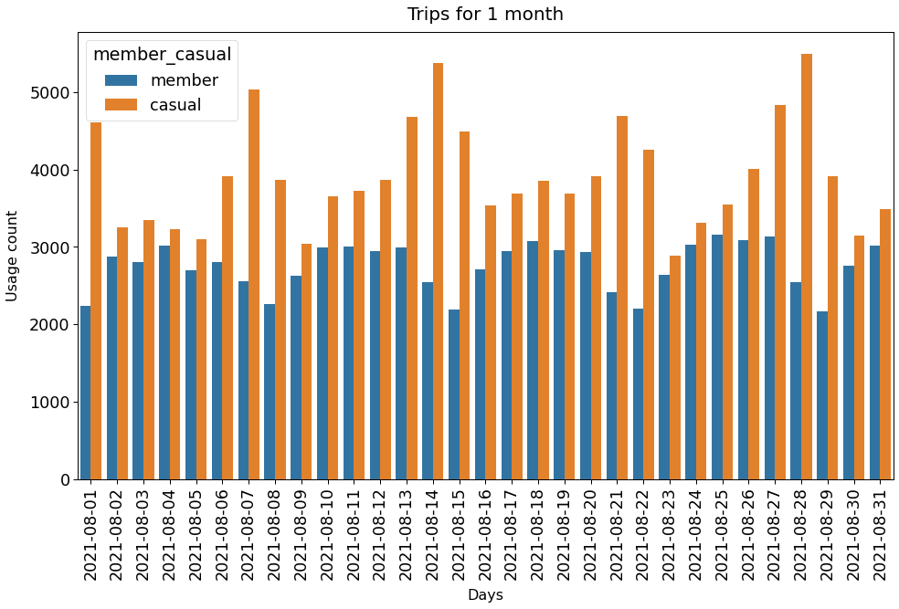
Summary statistics and metrics
Bike ride trend for 1 month (range of dataset) per user type
Observation : Bike ride trend shows that demands changes periodically
Member(registered user)'s ride count decreases during the weekend(8/1, 8/8 ~ 8/29 are Saturday) while casual(unregistered) users count increases during the weekend.
This is aligned with initial observation and support the hypothesis that member mostly use bikes for commuting purpose
Interesting finding
One can visually observe that there is a growing demand. This will be further investigated in the next section
Slight demand increase can be visually observed

Slide 14
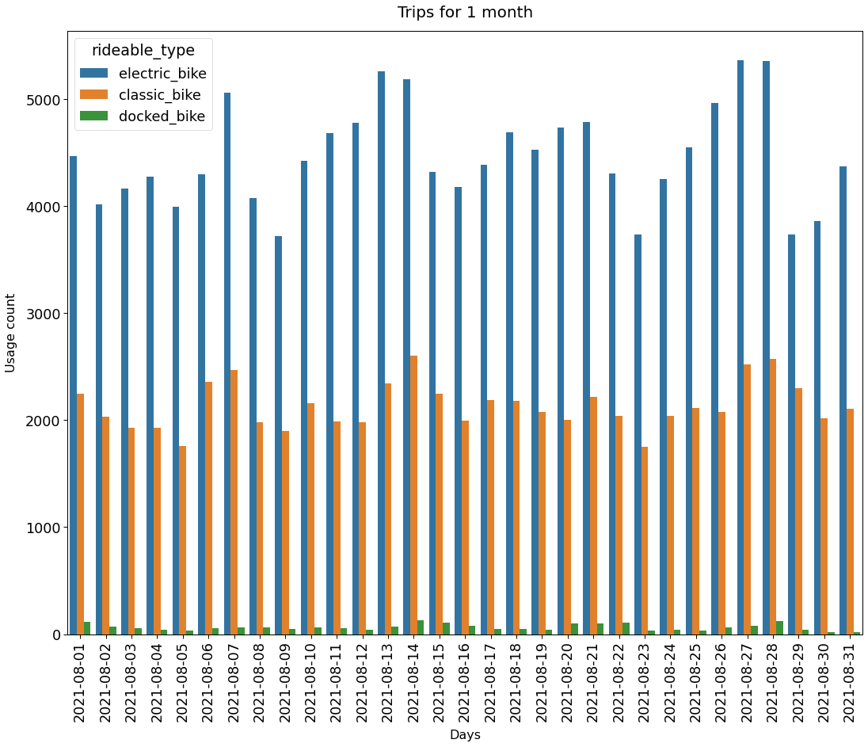
Summary statistics and metrics
Bike ride trend for 1 month (range of dataset) per bike type
Since the previous bike type analysis showed that electric bikes are more popular than other types of bikes, it is worth investigating demand for the given time duration
Observation & finding : Bike ride trend shows that demands changes periodically
This is aligned with initial observation and support the hypothesis that member mostly use bikes for commuting purpose

Slide 15
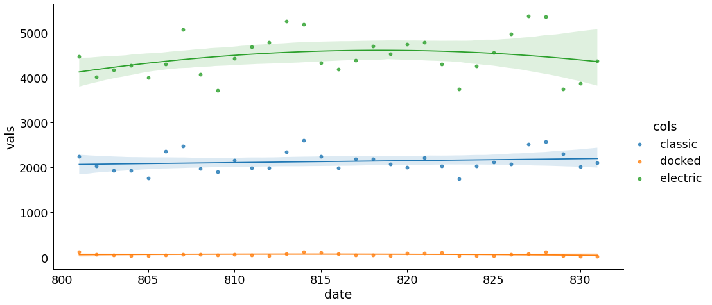
Summary statistics and metrics
Bike ride trend per bike type with regression line
Due to insufficient data points, regression line showed slight decrease at the end. More data point can help improve this phenomenon or support our hypothesis better
Observation: The second order regression plot for bike ride per bike type shows that there is a growing demand for electric bike ride while other bike types don’t change
Due to short time frame data, regression line got distorted at the boundary of the data.
If there were more monthly ride data, more clear bike ride statistics could be identified.
This could be important statistics that can help purchase department plan the future bike purchase plan with limited budget
Date : converted to integer for regression: i.e 805 → 8/5

Slide 16
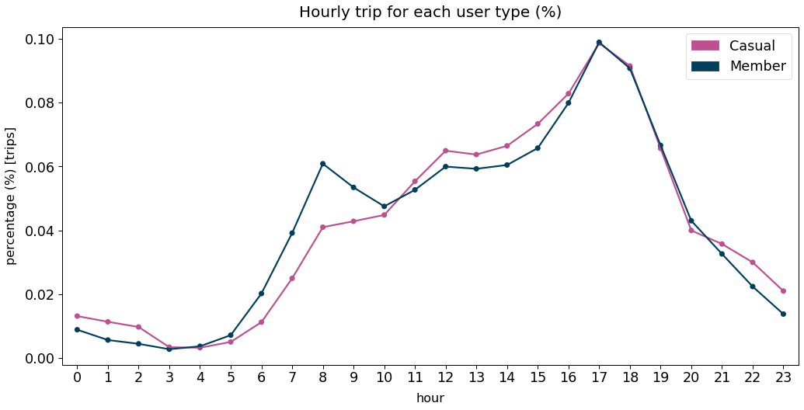
Summary statistics and metrics
Hourly trip data per user type during a day
Observation
Hourly data shows that member rides bike mostly at 5 pm and 8 am.
Hourly data shows that casual user tend to ride bikes more in the afternoon
Both user types rides bikes most at 5 pm when most people start to return home
This is also aligned with initial hypothesis that member uses bike for commuting since 5 pm and 8 am are the rush hour time.
Peak ride at 8 am and 5 pm for member
8 am and 5 pm are rush hour time zone

Slide 17
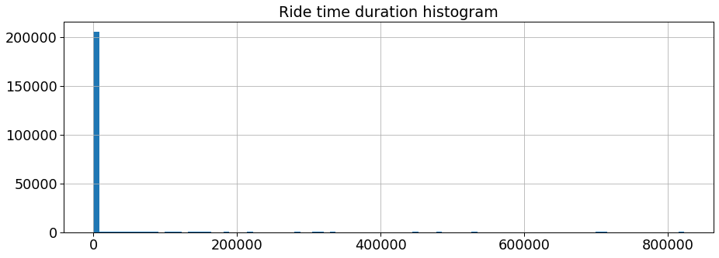
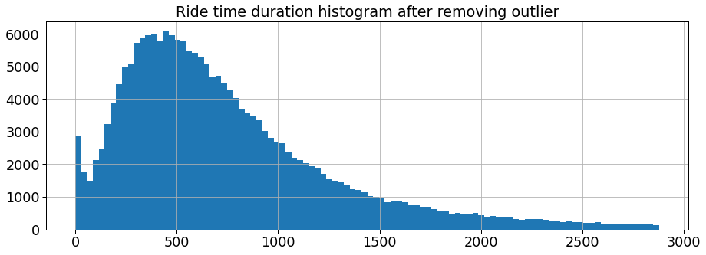
Summary statistics and metrics
Ride time duration
Severely right skewed ride time duration data
Observation
To check the ride time duration, the time duration in time delta format is converted to second format. Then histogram of the data was analyzed in the first histogram "ride time duration histogram"
The result shows that some users kept bike more than days, which makes histogram severely right-skewed.
Data with ride time duration > 48 hours are removed as outlier
After removing the outlier, the data shows clear trend. It's still right-skewed overall and around 500 minutes(8.5 hours) are the median ride frequency data point. This time matches the most common work hour 8.5 hours
After removing time duration >48 hours, more reasonable distribution can be achieved

Slide 18
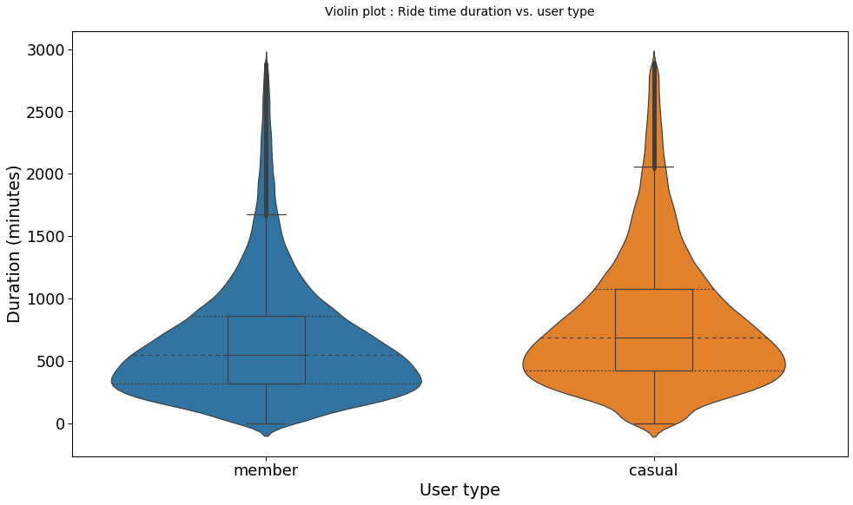
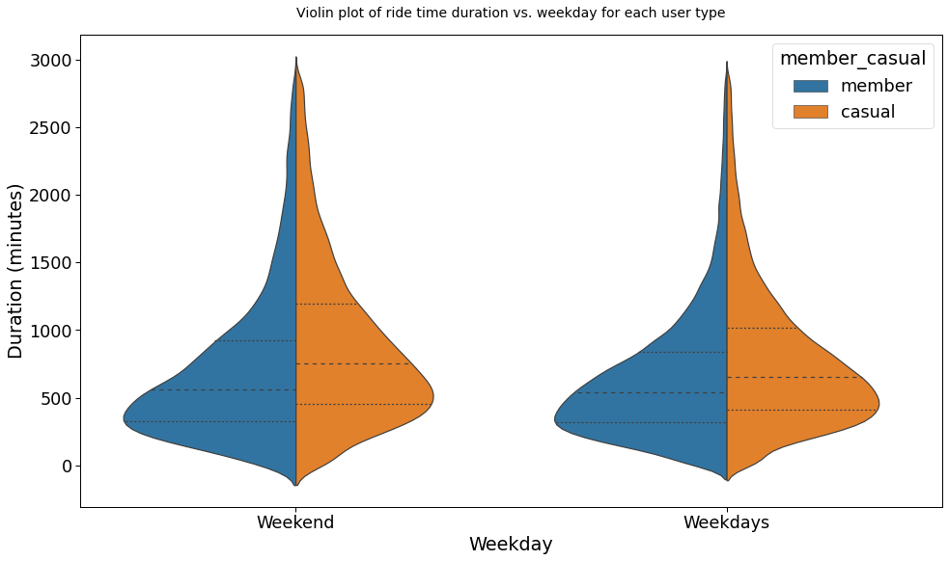
Summary statistics and metrics
Violin plot of ride time duration per member and weekend/weekdays
Observation :
The casual users have more ride time duration : Higher median value in the box plot
The ride time duration of most of the members are 500 min (8.5 hours): largest width around 500
The ride time duration of most of the unregistered casual user : 3 hours longer than member's ride time.
The casual user has wider time duration distribution : Max point of box plot is much higher than member’s max point
Casual user’s ride pattern is not similar to each other
There is not much difference between weekend and weekdays for both types of users
Casual users have wider distribution
Around 3 hours difference

Slide 19
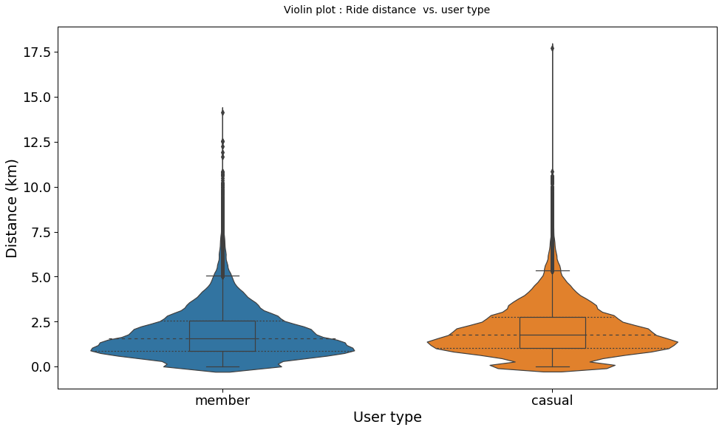
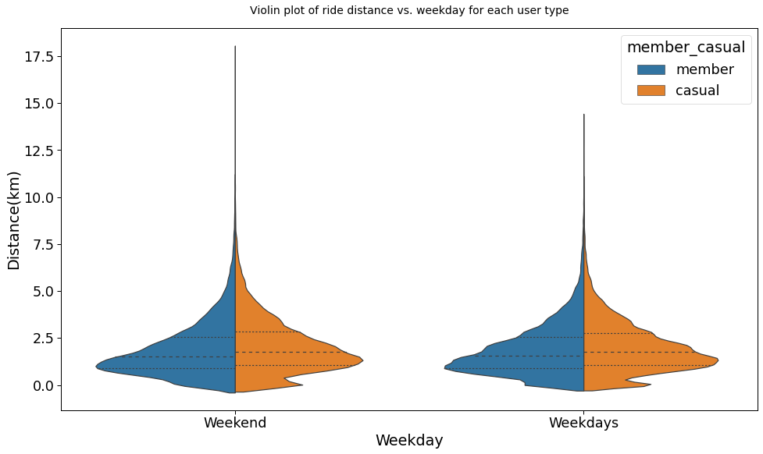
Summary statistics and metrics
Violin plot of ride time distance per member and weekend/weekdays
Observation :
The median bike ride distance of member is around 1.7 km which is 10 ~20 min distance from the station location
The median bike ride distance of casual user is around 2 km which is slightly higher than member user’s travel distance and much wider distribution

Slide 20
Conclusion
Throughout the analysis, 2 simple metrics, time duration and travel distance were created. Also 1 new dimensional feature called “bike occupancy index” was created
Geographical bike ride location distribution shows that most bike rides are concentrated on few popular station. More bike need to be prepared in those locations
The summary statistics give us the following information
It is highly possible that member uses bike for commuting while casual user use bike for other purpose such as sight seeing
Member user’s bike usage pattern is more predictable
Casual users prefer eclectic bikes than other types of bikes
Casual users ride bikes mostly during the weekends while members ride bikes mostly during weekdays
Casual user occupies bike for longer time and return late during weekdays
By providing promotion or credit to early return user, bike utilization efficiency can be improved during weekdays
The regression plot shows that there is a growing demand for electric bikes compared to the other bike types
It is recommended to purchase more electric bikes to boost bike sharing service
From page 8, casual user also preferred electric bike than any other bike types
Remaining questions
The data only contains August bike ride data. By analyzing monthly and yearly bike ride trend data, better regression analysis could have been done

